Slide 1



ProductDashboard_Challenge_Finish
View in Power BI
Last data refresh:
3/22/2021 7:56:10 AM Central Standard Time
Downloaded at:
3/22/2021 7:57:59 AM Central Standard Time

Slide 2
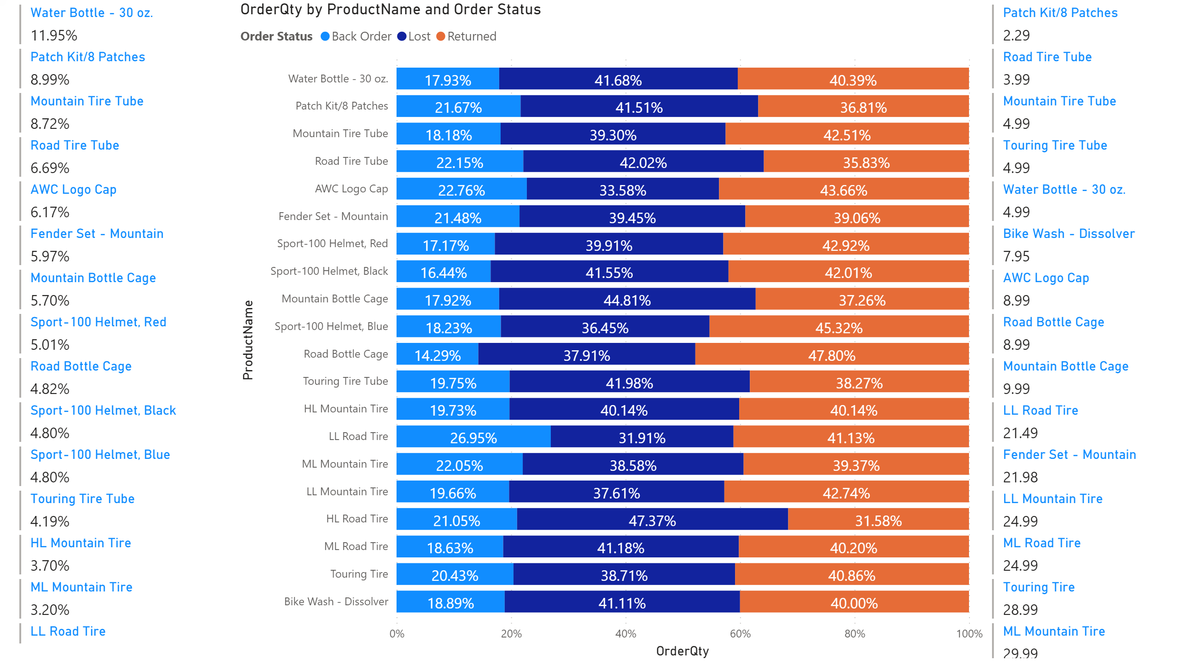
FirstDraftProducts
Notes:
multiRowCard
No alt text provided.
hundredPercentStackedBarChart
No alt text provided.
multiRowCard
No alt text provided.

